Slide 1
Social and Economic Impact of Food Deserts Group 10

Slide 2
team & scope
Scope
“ Analyze USDA and US Census data for food deserts, map its geographic locations and identify various correlations”
Group 10 Team Members
Katy Fuentes
Jana Warri
Igor Pavlunin
Oluwadamilare Alade
Hardik Vadel

Slide 3
Contents
FOOD DESERTS
What are food deserts and why study them?
Food Deserts in the US - Geomap
Some facts
FOOD DESERTS AND CORRELATIONS
Food Deserts and SNAP Benefits
Housing Units without Vehicle (HUWV) in food deserts (FD)
Food Deserts and Chronic Conditions
Food Deserts and Poverty rates
Food Deserts and Median Income

Slide 4
What are Food deserts and why study them?
USDA defines a food desert as:
“ Low-income census tract with a substantial number or share of residents with low levels of access to retail outlets selling healthy and affordable foods.”
Food deserts have been connected to many socio-economic problems
Analyzing information may identify specific key elements associated to food deserts
This project and associated insight can assist in formulation of governmental policies

Slide 5
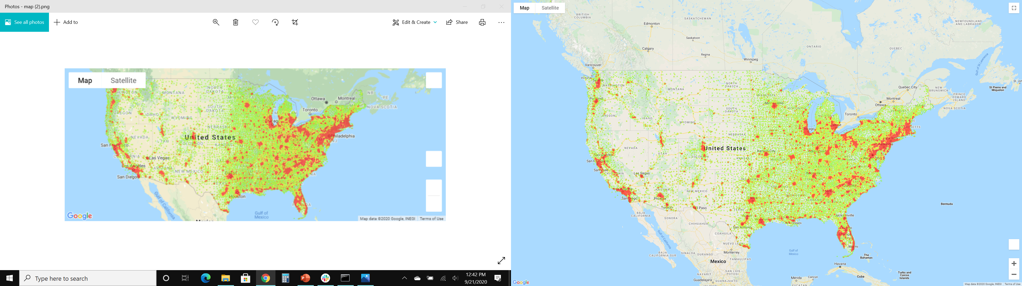
Food deserts in the us - geomap
Notes:
Consider talking about:
Afghanistan
Mexico
Singapore
United States
Democratic Republic of Congo

Slide 6
Food deserts & SNAP benefits
Notes:
Consider talking about:
Stunting and chronic nutritional deficiencies
Depression, anxiety, and sleep disorders

Slide 7
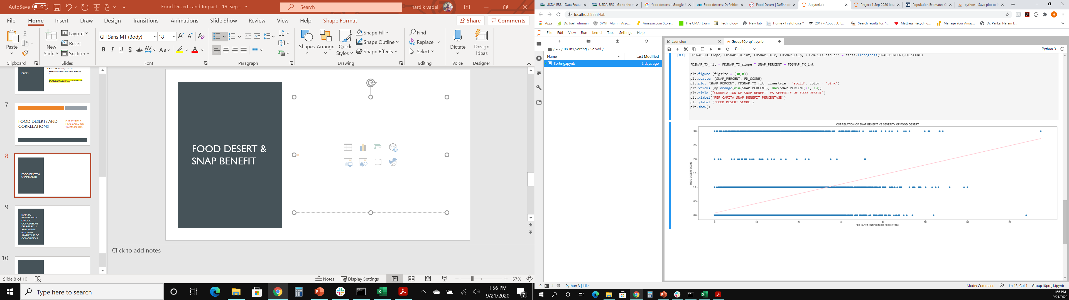
Food desert & SNAP expenditure- California

Slide 8
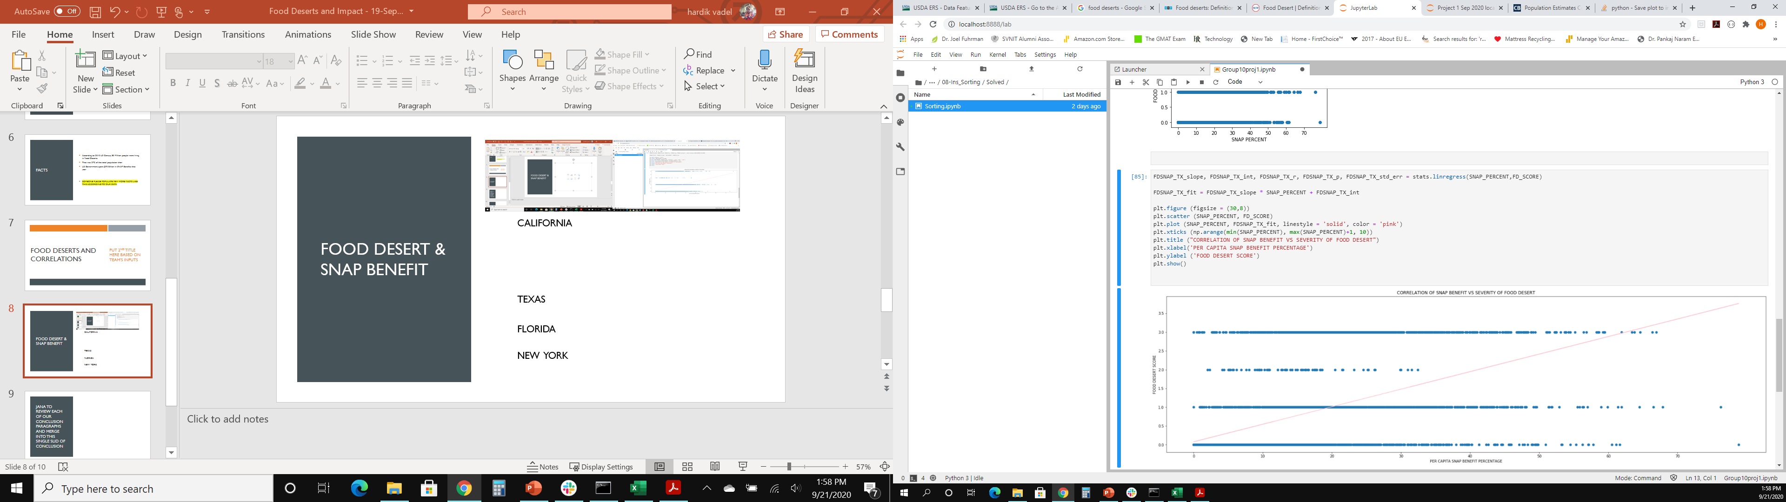
Food desert & SNAP expenditure- texas
CALIFORNIA

Slide 9
Snap benefits & conclusion
Based on state specific data analyzed for three most populous states, there is a linear correlation between number of households receiving SNAP benefits and intensity of food desert impact.
About 83 million US citizens or 27% of the total population in 2015 were impacted by food desert.
The higher the food desert score, the higher the percentage of SNAP benefits used.
Along with these insights, it was reported that the US spent $70 billion on SNAP.
NATIONAL DATA – SNAP BENEFITS AND FOOD DESERT SCORES
Government incentives viz., tax breaks towards starting grocery stores in these locations can reduce continually investment in SNAP benefits
CATEGORY | VALUES
FOOD DESERT SCORE | 0 | 1 | 2 | 3
Mean of Households with SNAP (%) | 10.30% | 24.01% | 16.84% | 22.705%

Slide 10
Limitation
Inconsistencies in data sets between USDA and US Census Gazeeter lead to a loss of @ 2% of data set. That is roughly 2000 data set loss over 74000 total data sets
Google places “Terms” do not allow for storing and counting business information. This impeded the team from establishing a correlation between fast-food restaurants and food deserts.

Slide 11
Housing Units without Vehicle (HUWV) in food deserts (FD)
Notes:
Consider talking about:
Stunting and chronic nutritional deficiencies
Depression, anxiety, and sleep disorders

Slide 12
Top 5 states hunv for fds1 & fds3

Slide 13
Data exploration
Data distribution for HUNV is not normal but following Poisson model instead.
In this case LinReggr and TTest is not the best option to obtain data driven decisions but still can be used for demonstration purposes.

Slide 14
Manual correlation plot
Hunv vs Food Deserts
FDs 1 has the highest number of HUNV across the states
FDs3 has less HUNV across the states
FDs2 has smallest number of HUNV across the states

Slide 15
Manual correlation plot
Hunv/low income population vs FDs
Low income population correlates almost linearly with HUNV in food deserts

Slide 16
LinRegress test (demonstration only)

Slide 17
ttest (demonstration only)
Independent Ttest – FDs 2
1sample Ttest – FDs 3

Slide 18
FOOD Deserts and HUNV Limitations
Data from the 2010 Census2 related to Housing Units without Vehicle are not normally distributed
Due to Poisson data distribution LinRegress and TTest are meaningless (normal data distribution is a key requirement for mentioned tests)
Despite of Poisson data distribution mentioned, tests are performed for demonstration purposes only
Limited numerical precision to correlation outputs, since linear graphical correlation plots are used

Slide 19
FOOD Deserts and HUNV conclusion
Data limitations and visual correlation Housing Units without Vehicle (HUNV) distributed in the food deserts includes:
Food Desert 1 has the highest number of HUNV across the states
Food Desert 3 has less HUNV across the states
Food Desert 2 has smallest number of HUNV across the states
HUNV distribution in food desert score 1 and 3 across the states are not the same (top 5):
Food Deserts 1 – CA, PA, TX, OH, FL
Food Deserts 3 – TX, OH, FL, GA, NC
Low income population correlates on average linearly with HUNV in food deserts
Government support for short/long term loans, tax breaks for auto-dealers (to allow lower prices) in food deserts may help reduce households without vehicles and improve household access to quality food sources

Slide 20
food deserts & Chronic conditions
Notes:
Consider talking about:
Stunting and chronic nutritional deficiencies
Depression, anxiety, and sleep disorders

Slide 21
FOOD Deserts and Chronic conditions Overview
Objective is to verify if a connection exists between chronic conditions across food deserts by correlating Medicare spending as a proxy for the prevalence of chronic conditions
Primary data source 2015 Gazetteer Files linked to the 2010 Census
Secondary data source Data Centers for Medicare & Medicaid Services spending on 21 chronic conditions
Accounts for actual Medicare spending per capita for claims processed in 2015
Medicare beneficiaries with any of the specific conditions presented may have other health conditions that contribute to their Medicare utilization and spending amounts

Slide 22
FOOD Deserts and Chronic conditions Limitations
Data exists for 21 chronic condition categories however analysis was performed on Depression, Diabetes, Cancer, national totals, and state summary statistics
Medicare state and county information was segmented by individual county tract whereas Census information includes multiple county tracts
Several issues with merging the data and proper data types
Grouped data by Census county and state
Food desert are ranked with scores of 1 through 3, with 3 being the highest/worst

Slide 23
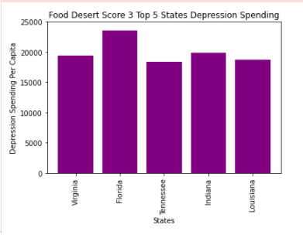
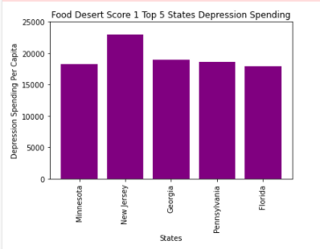
FOOD Deserts and Chronic conditions Depression Analysis

Slide 24
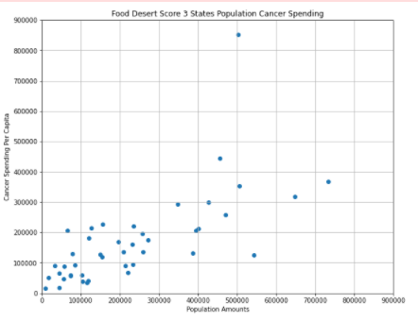
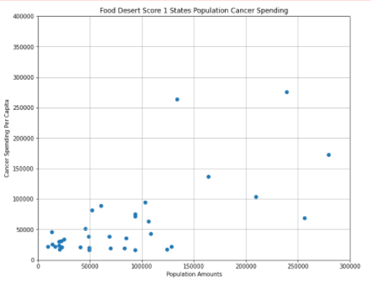
FOOD Deserts and Chronic conditions Cancer Analysis

Slide 25
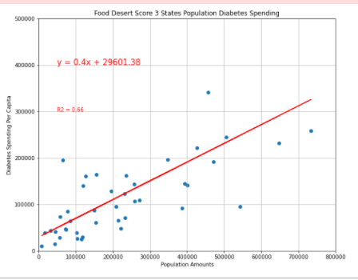
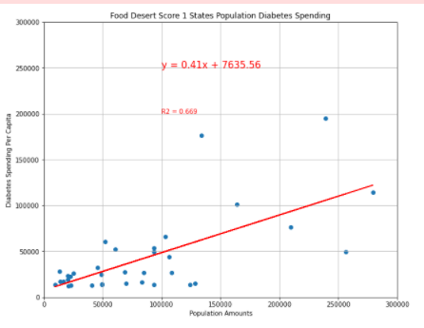
FOOD Deserts and Chronic conditions Diabetes Analysis

Slide 26
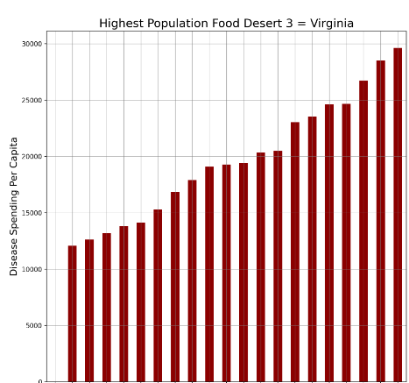
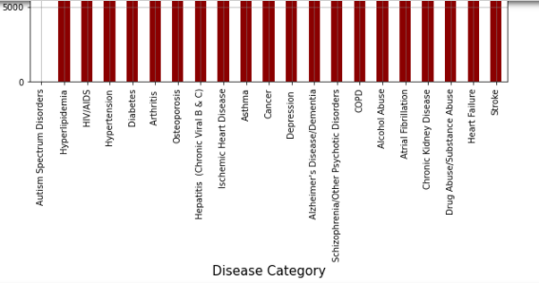
FOOD Deserts and Chronic conditions Virginia Analysis

Slide 27
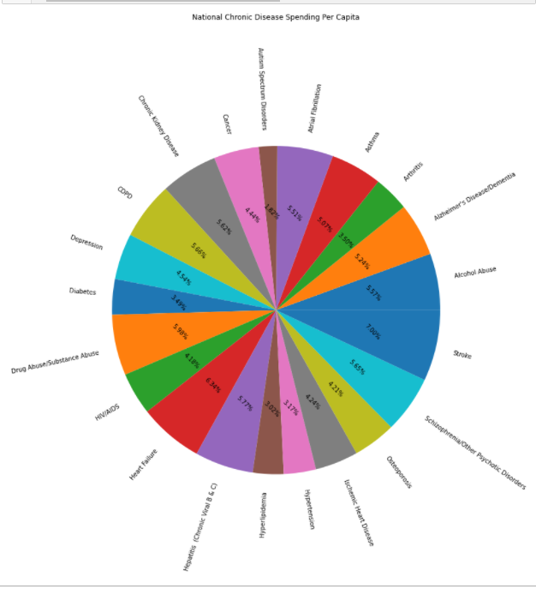
FOOD Deserts and Chronic conditions National Analysis

Slide 28
FOOD Deserts and Chronic conditions Conclusion
Depression
Spending is consistent in food desert categories 1 and 3
Cancer
Spending is higher in food desert category 3 versus 1
Diabetes
Food desert categories 1 and 3 both have a correlation coefficients of r²=.66
Other Data Findings
Virginia had the highest population and number of category 3 deserts
National spending by chronic condition is evenly distributed between 3-6%
Outliers: Autism 1% and Stroke 7%
Nationwide category 3 food desert’s total median spending on Drug Abuse/Substance: $141,926
States median total spending on Ischemic Heart: $1,023,352
Notes:
Chronic condition information was stored in Excel file so had to convert to CSV and clean up some titles and remove asterisks to ease data integration. The asterisks represent data suppression because there were insufficient Medicare beneficiaries.
State difference between nationwide state and county and national information provided in the data set.

Slide 29
Poverty rates in food deserts
Notes:
Consider talking about:
Stunting and chronic nutritional deficiencies
Depression, anxiety, and sleep disorders

Slide 30
Poverty Rate in food deserts Overview
Objective is to verify if a connection exists between deserts and the poverty rate in a given state by correlating the National food desert rating by the CDC and the median family income of the inhabitant
Data source 2015 Gazetteer Files linked to the 2010 Census

Slide 31
FOOD Deserts and Poverty Rate Limitations
The data set is limited to 2010, has no indication of household size or the average age of household occupants.
No data to explain possible changes in population for a give state.
Grouped data by state to narrow the area and calculated the median poverty rate % to use in my analysis. In addition, limited my population to area with a food desert core of 3 or more.

Slide 32
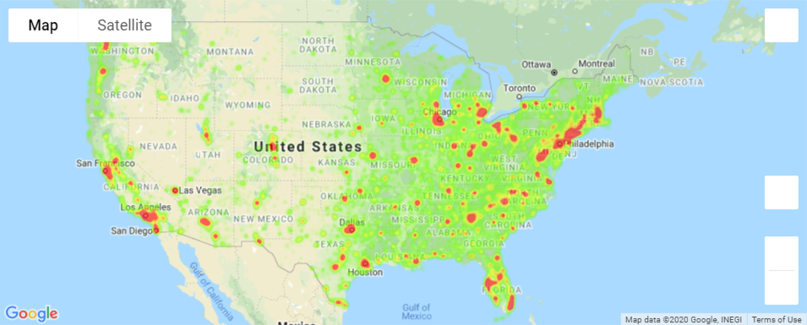
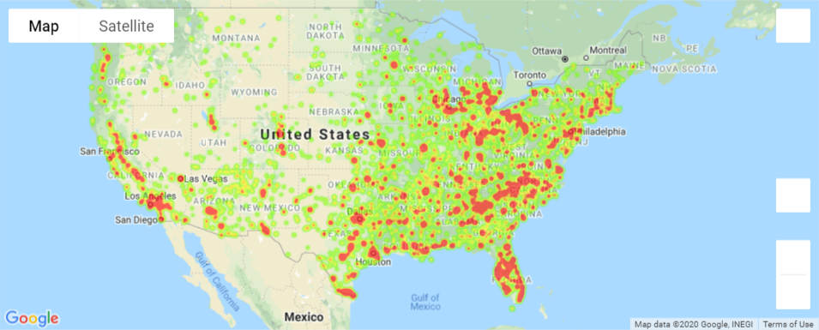
Poverty Rate in food deserts
National Food Desert
National Poverty Rate

Slide 33
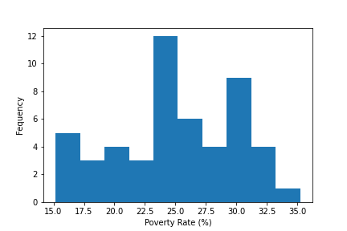
Poverty Rate in food deserts
Normal Test Result, statistic=2.7129841778917414
Pvalue=0.2575627011402239)

Slide 34
Median Income and food deserts
Notes:
Consider talking about:
Stunting and chronic nutritional deficiencies
Depression, anxiety, and sleep disorders

Slide 35
Median Income and food deserts
What is the number of people living below poverty level in food deserts?

Slide 36
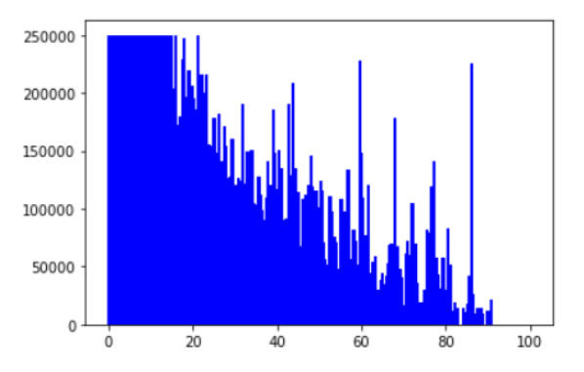
Median Income and food deserts Analysis- Median Income and Poverty rates

Slide 37
Median Income and food deserts Conclusion
Earnings are below $25,465 for a family of 2 adults and 2 children.
Nearly 13 million kids are living in poverty.

